Slide 1

Equal Opportunity & Nondiscrimination
Investigator Training
Office of Equity and Inclusion
November 13-14, 2024
MinnState.edu

Slide 2
Outline of Today’s Presentation
Brief review
Investigation Techniques​

Slide 3
Brief Review of Policy and Procedure

Slide 4
Designated Officer Tasks
Jurisdiction and scope
Conflicts of interest
Interim actions re: health, safety concerns
Primary person to ensure process moves forward through each relevant step of the procedure
Release of information requests

Slide 5
Investigator Tasks
Conducts a fact-finding inquiry or investigation of the complaint, including scheduling and holding interviews and requesting record information; may delegate this to another trained investigator
Informs involved parties of right a union representative or support person to accompany them during investigative interviews, as appropriate
Informs involved parties of the protection and prohibition of retaliation per policy
Creates, gathers, and maintains investigative documents as appropriate

Slide 6
Investigator, Continued
Writes investigation report with organized attachments
Outlines facts in the investigative report based on information collected through the interview process and review of gathered documents
Primary person to ensure process moves forward through the investigative steps
Handles all data in accordance with applicable federal and state privacy laws, consulting with the campus Data Practices Officer when necessary
Provides all investigative materials to the Designated Officer for recordkeeping

Slide 7
The Investigation
Provides enough information for the decisionmaker to make a reasoned decision about whether policy has been violated
Maintains integrity of process
  Timely
  Fair to both parties
  Provide confidentiality as required by law
  Thorough
  Tailored to individual circumstances
Provides findings of facts, not findings of policies

Slide 8
Decision-maker Tasks
Determines whether there is any real or perceived conflict of interest
Receives and reviews the investigation report
Provides notice to the Complainant and Respondent regarding receipt of report, their role as Decisionmaker, and anticipated timeline for decision
Makes sure the investigator has complied with Minnesota State procedures
May meet with parties or request additional information from the investigator

Slide 9
Decision-maker, concludes process
Decides whether policy has been violated based on information provided in report
Writes reasoned decision based on facts, available information, and policies
Provides decision letters to complainant and respondent of their findings regarding a policy violation; copy to the Designated Officer
Provides all related report materials to the Designated Officer for recordkeeping

Slide 10
Deciding if Misconduct Occurred
Standard of proof in determining a 1B.1 violation
  Preponderance of evidence; i.e. more likely than not to have occurred
  Secondary information has value
  Reasonable inferences also are used
The scales of justice:
Preponderance= > than 50%
Clear and convincing= 75% vs. 25%
Beyond a reasonable doubt= 99.9% vs. .1%

Slide 11
Decision Factors
Weigh nature and context of behaviors, the relationship(s) between the parties, the context in which the alleged incident(s) occurred, and other relevant factors
Consider the totality of circumstances
  History of complaints/grievances
  Treatment of others (those who are different and those who are similarly situated)
  Skills/competencies of supervisors demonstrated by past actions
What is more convincing and has greater probability

Slide 12
Investigation Skill-building
Maegen Sincleair Usher, JD (she/her)
Investigation Specialist & Deputy Title IX Coordinator
Metro State University

Slide 13
Part 1: Investigation Strategy

Slide 14
Investigation Scope
Scope of Investigation
  What are the allegations?
    1B.1, 1B.3, RWP, Code of conduct, etc.
    What are sub-elements
    Partnership w/ other departments
  Who are the involved parties?
    Multiple respondents; multiple complainants – may consider splitting
  Do the allegations arise out of same set of facts
    If not, consider splitting or referring non 1B.1/1B.3 matters
    Allegations for each specific Respondent
  Why is scope important?
    Prevents Scope creep i.e., getting lost/sidetracked
    Can help structure interviews

Slide 15
Creating investigation plan
Outline the scope
  Complainant(s); Respondent(s); policies, allegations
Allegations
  What are the elements
  Track information that goes to each element
Witnesses
  Large witness pool
  Name, role, who identified by, information they possess, interview date, evidence submitted
Investigative questions
  Outline for each party
Evidence
  Received; Needed

Slide 16
Collecting Evidence
Initial evidence to collect and review
  Time sensitive evidence
    Security footage
    Keycard access
    University owned devices
  Standard records to review
    Internal past 1B.1/1B.3 records
    Personnel files
    Conduct records
    Reports: security, residential life, etc.
    Org. Charts
  Create a timeline
    Continue to grow as more information is gathered
  Tracking
    Who provided what and/or where it was found

Slide 17
Types of Evidence
Direct Evidence
  Evidence based on personal knowledge or observation of a fact (can include documentary evidence)
Documentary Evidence
  Written or recorded material used to prove its contents
Circumstantial Evidence
  Direct evidence of a fact from which a person may reasonably infer the existence of another fact
  Statements or behavior in other situations that support or refute alleged conduct
Character Evidence
Corroborating evidence
  any admission or rationalizing of conduct; specific denial; witnesses with the opportunity to observe, recognize, or understand the situation
Hearsay Evidence

Slide 18
Types of Evidence, cont.
Hearsay Evidence
  Information received from other people that one cannot adequately substantiate; rumor
  Offered to prove the truth of matter asserted
Exceptions to hearsay
  Excited utterance
  Present sense impressions
  Recorded recollection
  Records of regularly conducted business activity
  Public records and reports
  Records of vital statistics

Slide 19
Examples of evidence
Personnel files/conduct records
Meeting minutes
Emails, voicemails, text messages. Etc.
Security or Residential life report
Social media records
Supervisory notes
Grading data
D2L records

Slide 20
Partnerships to obtain evidence
Security
Student Conduct/Student Affairs
Human Resources
Residential Life
Athletics
Other campus processes
Ombudsperson
Campus advocate
Law enforcement

Slide 21
Who to interview
Complainant & Respondent
Witnesses
  Those present in incident(s)
  Outcry witnesses – administrators, friends, family complainant/respondent shared with about incident(s)
  Those involved in documenting incident or process/response - security, other administrators, etc.
  Focus on witnesses that have knowledge of the incident rather than the character of the individual
Document interview decisions
  Who is doing the interview and why
  Why was someone not interviewed

Slide 22
Scheduling Interviews
Order of interviews
  Strategy – different order for different situations
    Witnesses – may be helpful to start w/ "neutral persons"
Timing
  Set aside enough time: prep, interview, notes/reflection time
  Consider past interactions with party
  Consult interview outline
Flexibility – timing and location
  Provide location options but be sensitive to different needs.
  i.e., - Zoom requires technology, internet, etc.
Accommodations
  Know who/what departments to partner

Slide 23
Types of meetings and interviews
Complainant
  Intake
  Investigatory interview
  Follow-up interview
Respondent
  Initial meeting
  Investigatory interview
  Follow-up interview
Witness
  Investigatory interview
  Follow-up interview

Slide 24
Notice of Meetings
Complainant
  Outreach letter
  Notice of formal investigation – Notice of Informal Resolution
  Notice of investigation and decline to file letter
  Notice of reassignment
Respondent
  Notice of review
  Notice of investigation (formal or informal) and allegations
  Notice of reassignment
Witness
  Witness Pre-interview letter

Slide 25
Meeting structure
Interview structure consistent for all parties
  "speeches" - overview of meeting, about role/office, etc.
  Review allegations – respondent meetings
  Background – name, title/year, etc.
  Interim actions and supportive measures
  Resources
  Next steps
  Reminder about retaliation

Slide 26
Part 2: Strategies for managing investigation-based challenges

Slide 27
Bias
A disproportionate prominence in favor of or against an idea or thing, usually in a way that is closeminded, prejudicial, or unfair
  Can be innate or learned
  Bias can be for or against an individual, group, or belief
Title IX requires a college or university to conduct a “prompt, thorough and impartial inquiry.” ​

Slide 28
Types of Bias
First Impression Bias
Affinity Bias
Confirmation Bias
Attribution Bias
Characteristic based bias
  Race, ethnicity, gender, religion, sexual orientation, socioeconomic, educational, etc.
Anchoring bias
Beauty Bias

Slide 29
Sexual Violence Case Specific Biases
The subject matter of these cases is often personal and very intimate
Most of us hold our own conscious beliefs and practices when it comes to this content area so it is important not to intentionally or unintentionally cast your lens on the matters you investigate
  Your own sexual experiences
  Moral or religious views about sex
  Comfort level in using terms – subject matter

Slide 30
Alcohol and Drug Use Biases
You may have your own views on and experiences with:
  Alcohol use
  Drug use
These things may have impacted your life

Slide 31
Investigator-Specific Biases
Complainant/Respondent is likeable/sympathetic
Complainant/Respondent is not likeable/sympathetic
Repeat Complainant/Respondent
Fact pattern similar to a prior, unrelated investigation
Complainant/Respondent behavior patterns

Slide 32
Bias Impact on Investigation
Priming – Your pre-investigation or mid-investigation thoughts about the case
Phrasing – The way you ask a question can influence the answer – The misinformation effect

Slide 33
Rape Myth vs Common Behavior for Victims of Rape
Common Behavior for Victims of Rape
Delay in reporting
Change in account of what happened
Unexpected demeanor/disposition
Unexpected behavior
  Contact with person who caused the harm
  Desire to resume “normal” routine
  Subsequent sexual activity (sometimes with the person who caused the harm)

Slide 34
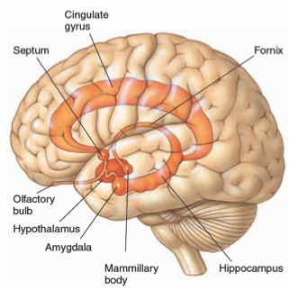
Neuroscience – The Limbic System

Slide 35
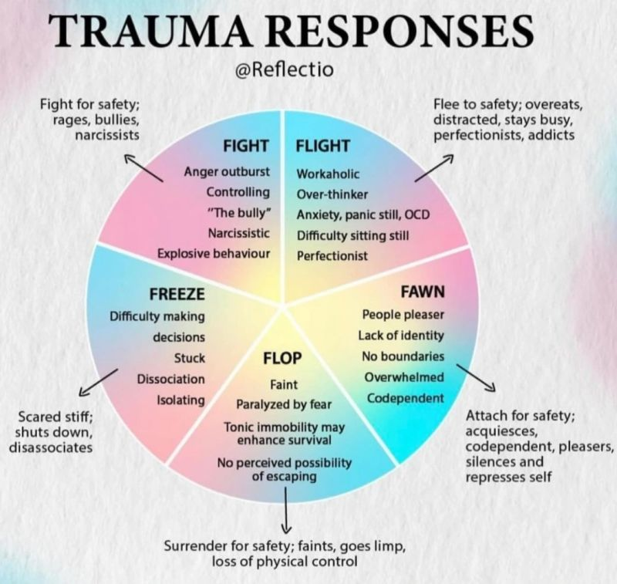
Responses of the Brain & Body During Trauma

Slide 36
Dissociation
Defense mechanism (of the brain) to protect against overwhelming sensations & emotions
  Occurs automatically, without trying
Portions (i.e., memories) of an experience that are normally linked together become “dis-associated”
Examples (during & immediately following a trauma):
  “Blanked out” or “spaced out” – in some way felt that I was not part of what was going on
  What was happening seemed unreal to me – like I was in a dream or watching a movie or a play
  Felt “disconnected” from my body

Slide 37
Tonic Immobility
Uncontrollable response
Mentally know what’s happening but physically unable to move (like being awake during surgery)
Rate of occurrence
  12 – 50% victim/survivors of rape experience tonic immobility during assault (most studies are closer to 50%)
Caused by:
  Fear
  Physical restriction
  “Perceived” inability to escape

Slide 38
Traumatic Responses and the Body
Physiology
  Heart rate, respirations, dilated pupils, dry mouth, knot in the stomach
Affective (mood and emotion) responses
  Fear, helplessness, horror
Cognitive (thought) processing
  Memory – fragmented, out of sequence
  Time distortion
  Increased confabulation
  Trauma memory and recall

Slide 39
Trauma and Memory
The body and brain react to and record trauma in a different way than we believed traditionally
Many professionals were trained to believe that even when a person experiences a traumatic event, the pre-frontal cortex records the vast majority of the event including: Who, What, When, Where, Why, and How
Memory recall can be very slow and difficult (or not possible)
  Memories are “fragmented” – they come only in bits and pieces (often do not follow a timeline)
  Process can be very frazzling and frustrating for victims
The Forensic Experiential Trauma Interview, Strand & Heitman

Slide 40
Memory phenomenon in traumatic situations
During trauma incident: Sensory overload, fixation on a particular aspect, miss other things
Immediately after: “post incident amnesia”—failure to remember most of what was observed
After a healthy night’s sleep: “memory recovery”—result in remembering majority of what occurred; probably most ‘pure’ recollection
Within 72 hours: final & most complete memory—but at least partially reconstructed after normal process of integrating other sources of information
By Lt. Col. Dave Grossman & Bruce K. Siddle
The Firearms Instructor: The Official Journal of the International Association of Law Enforcement Firearms Instructors
Issue 31 / Aug 2001

Slide 41
Impact of Trauma on Victim/Survivor Behavior
The effects of trauma can influence behavior of a victim/survivor during an interview
People are often reluctant to recall experiences that evoke negative feelings and emotions such as anger, fear, humiliation, or sadness
--Strand, 2013

Slide 42
Parallel Proceedings
Independent from any civil or criminal proceeding
Not required to delay, and in most cases should not delay due to other proceedings
May contact prosecutor/law enforcement to coordinator when feasible
Gather available information:
  Police Report
  Court records

Slide 43
Notice of Investigation and Allegations for 1B.3.1
Notice of Formal complaint
List of allegations
Presumed not responsible
Right to advisor of choice
Opportunity to provide information to be considered
Right to review and inspect evidence before investigation report finalized
10 calendar days to respond to investigation report
Option for informal resolution process
Retaliation
Investigator contact information

Slide 44
Part 3: Interviewing Approaches

Slide 45
Trauma informed techniques
Forming questions in a way that does not assign responsibility, blame, or guilt
Creating safe and comfortable interview environment/setting
Understand the effects trauma can have
Check your bias especially when assessing credibility
Ask questions that speak to the senses

Slide 46
Trauma-informed Approach
Create safe and comfortable interview environment/setting
Acknowledge sensitivity and difficulty of topics
Understand the effects of trauma and triggers
  Memory impacted, recall over time
  Emotions and sensory details may be triggers
  Varying emotions during interview
Attend to your own reactions or triggers

Slide 47
Trauma-informed Approach, cont.
Framing and phrasing meeting invitations, email communications
Pre-interview framing: “it’s okay if you don’t remember something today,” “sometimes it takes time to remember, which is okay”
Let Complainant talk uninterrupted and ask clarifying questions afterwards
Consider asking questions about the other senses
Do not insist in chronological order retelling; gather the information and organize it

Slide 48
Significant Time Between Incident And Report
The norm when the person causing the harm was not a stranger
Many victim/survivors are able to report only after they receive the necessary support to do so
Why do they wait? For many of the same reasons they later recant
  They fear repercussions
  They are pressured by others not to report
  They feel shame, embarrassment
  They are afraid of the person who caused the harm
  They are afraid of not being believed
  Fear that nothing will be done about it

Slide 49
Cultural Considerations
Communication styles
Attitudes toward conflict
Approaches toward completing tasks
Decision-making styles
Approaches to knowing
Attitudes toward disclosure
  Appropriate to share emotions, reasons for conflict
                --Sue Ann Van Dermyden, 2017

Slide 50
Common practice considerations
Be mindful of cultural differences
  Continuum of honesty and face-saving
  In-group vs. out-group
  Linear vs. non-linear narrative
Check biases, especially when assessing credibility
Ask questions in a way that does not assign responsibility, blame, or guilt

Slide 51
Determine goals of questions
Who, what, where, when, why, how
Intake meeting vs. Investigatory interview
Refine scope
What information are you missing or have questions
  Read through reports/complaints and note any questions
Policy elements
  Policy element handout

Slide 52
How to structure questions
Start with broad/open ended questions
Allow to tell their story/experience however they choose
  Where they start/end their story and what they emphasize can be very telling and important for you to have.
Clarifying questions
  Funnel approach
  Ask to clarify meaning of words/descriptors
Allow for Silence
Additional questions/things left unanswered
Closing questions
  Is there anything else you think I should know?
  Anything I didn't ask that you thought I would ask about?
  Is there anyone that you think I should talk to? Why?

Slide 53
Interview questions for ALL
Interview questions for all parties
  Allow them chance to share their story/experience
  Ask the who/what/where/when/how questions
  Summarizing Information back
  Policy elements
  Effect/impact

Slide 54
Interview questions continued...
Interviewee specific questions
  Respondent – make sure to review allegations before questions
  Complainant – clarify protected class and identity
  What they observed/their perspective of incident(s)
  Inconsistencies with other parties/witnesses
  Evidence specific questions – what they have, might have seen/been part of, etc.
  Desired outcome/resolution

Slide 55
Interview Considerations For credibility
Look for consistency with out-cry witnesses or contemporaneous reports
Assess demeanor
Ask yourself if the story is plausible?
  Consider relevant past acts; are there alternative versions that are more plausible
Compare overlap/consistency with other statements
Respondent who derails questions and/or focuses on irrelevant information
Providing inconsistent statements
Motives/Relationships
Positionality
Mind/memory altering substances

Slide 56
Analyzing certain qualities and factors
Demeanor: noted reactions to allegations or information shared; behaviors or feelings shared with others
Logic and consistency: consistency with what others shared (including possible witnesses); plausible explanations
Corroborating evidence: any admission or rationalizing of conduct; specific denial; witnesses with the opportunity to observe, recognize, or understand the situation
Circumstantial evidence: statements or behavior in other situations that support or refute alleged conduct
Note: trauma-informed approach

Slide 57
Each interview might look different
Emotion – crying, anger, indifference, being conflicted, shock, trauma, etc.
Timing – short answers, decisions to make, communication styles, etc.
How you ask questions
Credibility concerns
Effort needed to structure interview – redirect, diffuse conversation, etc.

Slide 58
Maintaining control of interview
Provide roadmap of interview
Safety – Think about how you have arranged the room, security, etc.
Union reps/ support persons/parents/lawyers
  Be clear about what their role is from the very beginning
  Allow for time and space for them to meet away from investigator
  Give reminders/warnings if necessary
Don’t be afraid to end a meeting
Difference between control and parties not cooperating

Slide 59
Providing empathy and validation
Focus on treating the individual as a whole person.
As an investigator, remain neutral
Practice using sample language that validates a person's experience but remains impartial
Remember allow space for decisions

Slide 60
Challenging interviewee tropes
The Clueless one
The Denier
The Distractor
The Confessor
The Explainer
The Apologetic one
The TV lawyer
The Avoidant one
The Questioning one

Slide 61
Note taking
Handwritten, typed, Teams transcript
Some of this is a personal preference – be consistent
Have outline of meeting/interview
Consider a notetaker for support
Model notes after investigation report
Make notations where you still have questions for follow up or for other parties

Slide 62
Common challenges & tips
Common challenges
  parties talk fast or talk in circles/share repetitive information
  interviews are long
  prioritizing typing notes after interview
  Self-care
Tips
  type notes/update as soon as possible after interview
  document thoughts for follow up
  have a notetaker
  encourage all to submit a written statement

Slide 63
Recording interviews
Allows the investigator to focus on content/information and being present during the interview
Recordings can ensure that all data and information is accurate.
  Provides for use of direct quotes
  Allows for investigator to review/reflect to determine what gaps still exist
  Provides investigator an opportunity to refine investigation skills
Recordings can be taken in multiple ways
  Teams, handheld, etc.
Record ALL the interview - including opening information, data privacy review (ask for verbal acceptance), all "housekeeping" information

Slide 64
Recording interviews, cont.
There are additional nuances of recording that are different from standard interviewing.
  Open recording stating date, time, and introduction of parties (including spelling of names). End recording with time.
  Audio recordings do not pick up on non-verbal (head nods, etc.) – prepare parties at beginning of interview and clarify during interview if needed.
Develop a plan for your recording - send for transcription, etc.
  This provides a typed/hard copy of the interview.
Transcription review
  Determine if you want to add this as a part of your process
  Who can attend to complete the review

Slide 65
Recording considerations
Contracts for transcription
  transcription services
Access to transcripts
  Who, when, why
Storage of recordings and transcripts
Data retention policies

Slide 66
Part 4: Components of Investigation Report

Slide 67
Goals of Investigatory report
Present findings in a well-written and well-organized format
Document the steps taken during the investigation
Document the evidence collected and reviewed
Provide a clear, objective picture of investigation to the DM
Should contain all information a DM needs to make their decision

Slide 68
Investigatory report components
Transmittal letter & Cover Sheet/Disclosure Notice
Investigation report cover page
  Date, report prepared for, report prepared by, nature of investigation, and complainant(s) and respondent(s)
Table of contents
Synopsis
Methodology
Evidence
Synthesis
Exhibit Index

Slide 69
Technical writing
Technical Writing
Focuses on explaining complex concepts clearly
Instructional, procedural, and often involves guidelines/manuals
Primary goal is to make technical information easy to understand and use
Written for a specific audience

Slide 70
objective writing
Objective Writing
Impersonal and factual
Focuses on being neutral and informative, ensuring the reader can make their own judgments
Focuses on credibility but avoids overt persuasions
Presenting facts without bias
Written for a general audience

Slide 71
Technical vs objective writing
Comparing technical and objective writing:
Both require clarity, structure and accuracy
Both are focused on fact-based and credible information
Share a purpose to explain or instruct without bias
Best practices:
Be concise and avoid unnecessary complexity.
Stick to facts and connect to relevant exhibits attached to investigatory report
Avoid language that can be

Slide 72
Assignment to Decisionmaker
DM Assignment Memo - Introduction of the investigation to DM
  Investigators contact information
  Parties' contact information
DM Checklist
MoveIT Securely Instructions
Investigation report and exhibits
Notice of DM Assignment sent to Complainant(s) and Respondent(s)
Update internal tracking
Copies to system office

Slide 73

Thank you.
30 East 7th Street, Suite 350
St. Paul, MN 55101-7804
651-201-1800
888-667-2848
MinnState.edu
This document is available in alternative formats to individuals with disabilities. To request an alternate format, contact Human Resources at 651-201-1664.
Individuals with hearing or speech disabilities may contact us via their preferred Telecommunications Relay Service.
Minnesota State is an affirmative action, equal opportunity employer and educator.

